Slide 1

Chandigarh School of Business, Jhanjeri
Department of Computer Application
Program Code:NA
Program Name: MCA
Course Code: PGCA1937
Course Name: Cloud Computing
Prepared by: Dr. Gurvir Kaur

Slide 2

Outlines
PTU Syllabus of Unit-I
CO’s Introduction
Topic Overview
Brief description of what the presentation will cover
Importance or relevance of the topic
Key objectives or learning outcomes
Summary
References

Slide 3
PTU Syllabus of Unit-I
Part-A
Overview of Computing Paradigm: Recent trends in Computing -Grid Computing, Cluster Computing, Distributed Computing, Utility Computing, Cloud Computing.
Introduction to Cloud Computing: Vision of Cloud Computing, Defining a Cloud, Cloud Reference Model, Deployment Model, Characteristics, Benefits of Cloud Computing, Challenges ahead. Cloud computing vs. Cluster computing vs. Grid computing.
Migrating into a Cloud: Introduction, Broad approaches to Migrating into the Cloud, The Seven-Step Model of Migration Into a Cloud.
Virtualization: Introduction, Characteristics of Virtualized environment, Taxonomy of Virtualization techniques, Virtualization and Cloud Computing, Pros and Cons of Virtualization, Technology Examples- Xen, VMware, Microsoft Hyper-V.
Capacity Planning: Introduction, Defining Baseline and Metrics-Baseline Measurements, System Metrics, Load Testing, Resource Ceilings, Server and Instance types; Network Capacity, Scaling.

Slide 4
Key objectives or learning outcomes
CO1 Understand the basic concept and importance of cloud computing.
CO2 Access the suitability of migrating to a cloud solution for different applications.
CO3 Compare and evaluate the virtualization technologies.
CO4 Monitor and manage the cloud resources, applications and data while addressing the security concerns.
CO5 Use cloud solutions offered by industry leaders for various applications.

Slide 5
CO Introduction
CO NUMBER | TOPICS | LEVEL
CO1 | Overview of Computing Paradigm: Recent trends in Computing -Grid Computing, Cluster Computing, Distributed Computing, Utility Computing, Cloud Computing. Introduction to Cloud Computing: Vision of Cloud Computing, Defining a Cloud, Cloud Reference Model, Deployment Model, Characteristics, Benefits of Cloud Computing, Challenges ahead. Cloud computing vs. Cluster computing vs. Grid computing. | 2

Slide 6
Topic Overview
Evolution and Integration: Recent trends in computing, such as Grid Computing, Cluster Computing, and Distributed Computing, focus on optimizing resource utilization across multiple systems.
These paradigms enable parallel processing and resource sharing, improving performance, scalability, and fault tolerance.
Utility computing refers to a computing model in which computing resources, such as processing power, storage, and software, are provided as a service over a network (typically the internet) and charged based on usage, similar to how utilities like water or electricity are billed. In this model, users can access these resources on-demand without needing to manage physical infrastructure.

Slide 7
Brief of what the presentation will
The presentation will cover the following points:
Trends in Computing
Utility Computing
Example
Payment Model
Risks

Slide 8
Importance of the topic
On-Demand Resource Allocation:
Users can request and scale computing resources (e.g., virtual machines, storage) based on their immediate needs. This eliminates the need for users to maintain excess infrastructure, as resources are provided as a service and can be scaled up or down quickly.
Pay-as-You-Go Model:
Similar to traditional utility services, users are billed for computing resources based on usage, whether it’s by the hour, minute, or data transferred. This is more cost-effective than traditional models where users would need to invest in expensive hardware upfront.
Elasticity:
Utility computing offers elastic scaling, meaning resources can be increased or decreased automatically based on demand. This is especially beneficial for businesses with fluctuating workloads.

Slide 9
Detail Topics
The ACM Computing Curricula 2005 defined "computing" as
"In a general way, we can define computing to mean any goal-oriented activity requiring, benefiting from, or creating computers. Thus, computing includes designing and building hardware and software systems for a wide range of purposes; processing, structuring, and managing various kinds of information; doing scientific studies using computers; making computer systems behave intelligently; creating and using communications and entertainment media; finding and gathering information relevant to any particular purpose, and so on. The list is virtually endless, and the possibilities are vast."

Slide 10
“Utility” Computing ?
Utility Computing is purely a concept which cloud computing practically implements.
Utility computing is a service provisioning model in which a service provider makes computing resources and infrastructure management available to the customer as needed, and charges them for specific usage rather than a flat rate.
This model has the advantage of a low or no initial cost to acquire computer resources; instead, computational resources are essentially rented.
The word utility is used to make an analogy to other services, such as electrical power, that seek to meet fluctuating customer needs, and charge for the resources based on usage rather than on a flat-rate basis. This approach, sometimes known as pay-per-use

Slide 11
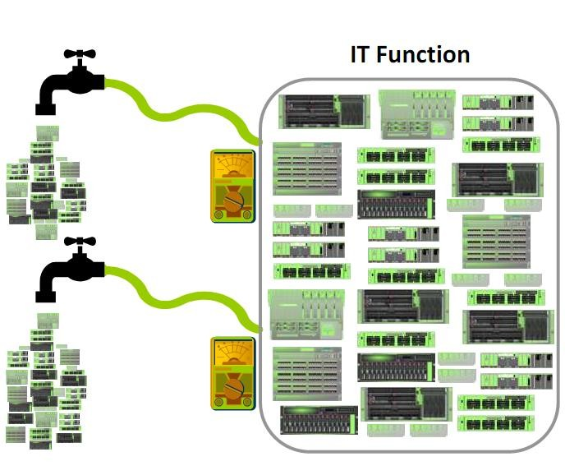
“Utility” Computing ?
"Utility computing" has usually envisioned some form of virtualization so that the amount of storage or computing power available is considerably larger than that of a single time- sharing computer.
Source:Alan McSweeney, “The Economics of Utility Computing”

Slide 12
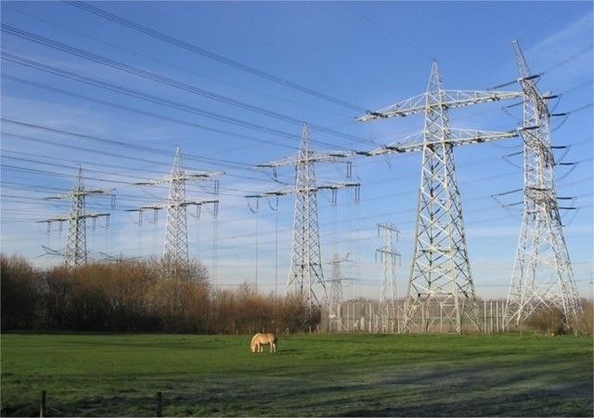
“Utility” Computing ?
Pay-for-use Pricing Business Model
Data Center Virtualization and Provisioning
Solves Resource Utilization Problem
Outsourcing
Web Services Delivery
Automation

Slide 13
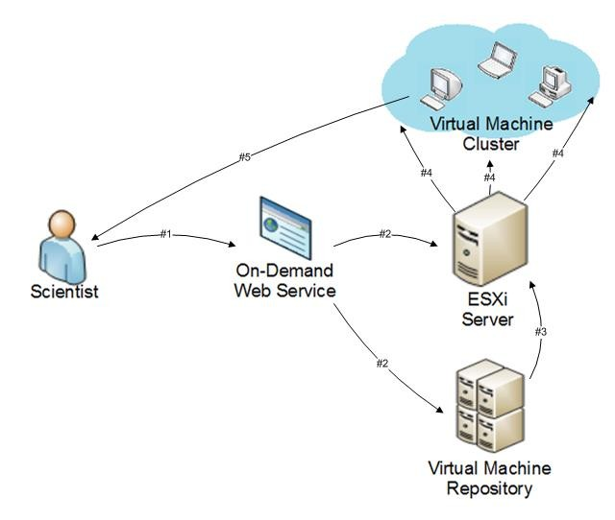
Utility Computing Example
On-Demand Cyber Infrastructure

Slide 14
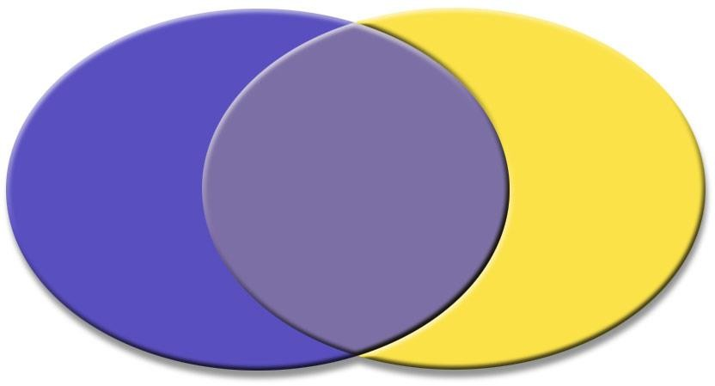
Utility Solution – Your
Perspective
vs
Consumer Provider
Service
Procurement
Infrastructure
Procurement
Service
Equipment Maintenance
Resource
Utilization Technology Refresh System Admins
Capacity
Assurance
Pricing
Availability
Contractor Management
Consultants
Security
SLA
Application Sizing
Planning
Source: Perry Boster, “Utility Computing for Shared Services”,
Massachusetts Digital Government Summit, September 23rd, 2004 –
Boston, MA

Slide 15
Utility Computing Payment
Models
Same range of charging models as other utility providers: gas, electricity, telecommunications, water, television broadcasting
− Flat rate
− Tiered
− Subscription
− Metered
− Pay as you go
− Standing charges
Different pricing models for different customers based on factors such as scale, commitment and payment frequency
But the principle of utility computing remains
The pricing model is simply an expression by the provider of the costs of provision of the resources and a profit margin

Slide 16
Risks in a UC World
Data Backup
Data Security
Partner Competency
Defining SLA
Getting value from charge back

Slide 17
Summary
Utility computing has revolutionized how organizations access and manage IT resources, offering significant flexibility, scalability, and cost benefits.
As technology continues to evolve, the model will adapt to incorporate newer innovations like edge and quantum computing, making it a cornerstone of modern IT infrastructure.
However, challenges related to security, reliability, and vendor lock-in must be carefully considered as businesses continue to embrace utility computing solutions.

Slide 18
References
Books References
Mastering Cloud Computing, Rajkumar Buyya, Christian Vecchiola, and ThamaraiSelvi, Tata McGraw Hill, ISBN-13: 978-1-25-902995-0, New Delhi, India,Feb 2013.
E-book link
https://archive.org/details/cloudcomputingbi0000sosi
YouTube link
https://www.youtube.com/@cloudcomputing351/videos
https://www.geeksforgeeks.org/cloud-computing/
https://www.tutorialspoint.com/cloud_computing/index.htm
https://nptel.ac.in/courses/106105167
https://www.edx.org/learn/cloud-computing

Slide 19
THANK YOU

